Slide 1

SPARK FUNDS INVESTMENT CASE STUDY
Lakshmi J
PGPMLAI

Slide 2
PROJECT BRIEF
Requirements from Spark Funds
Spark Funds wants to make investments in some companies and wants to understand the global trends in investments.
Constraints
Invest between 5 to 15 million USD per round of investment
Invest only in English-speaking countries for the ease of communication with the companies it would invest
Strategy
Invest where other companies are investing
Business objective :
Identify the best sectors, countries and a suitable investment type for making investments.

Slide 3
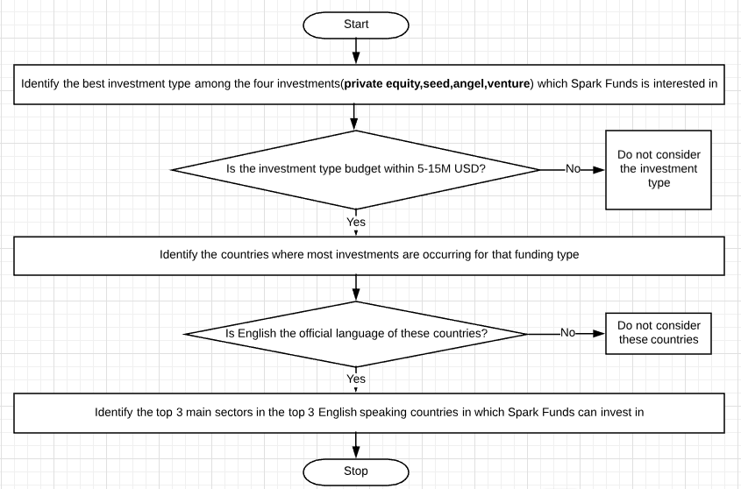
ANALYSIS
GOAL:
To find the most suitable main sectors among the top three English speaking countries which receive the most investment gain

Slide 4
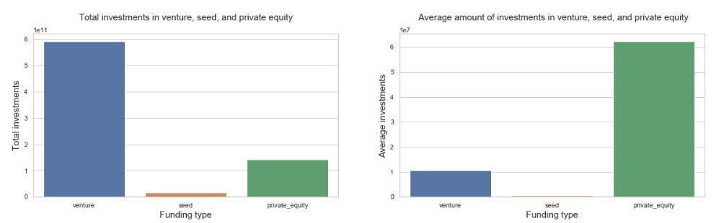
INVESTMENT TYPE ANALYSIS
Spark Funds is interested in investing for venture, angel, seed, and private equity funding types among other funding types
Given the constraint of Spark Funds investment amount to 5-15M USD, the best choice would be to choose Venture funding type
Best choice: USD 590B
Average between 5-15M: USD 10.7B

Slide 5
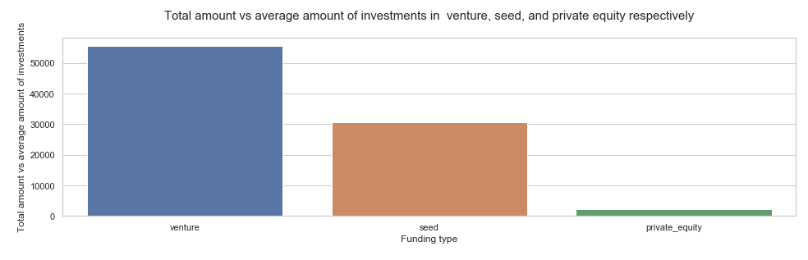
INVESTMENT TYPE ANALYSIS (contd.)
From the above chart representing the total amount of investment vs average amount of investments, Venture seems to be the clear winner. Hence, investing in venture funding type will be most beneficial (Checkpoint 6: Plot 1)

Slide 6
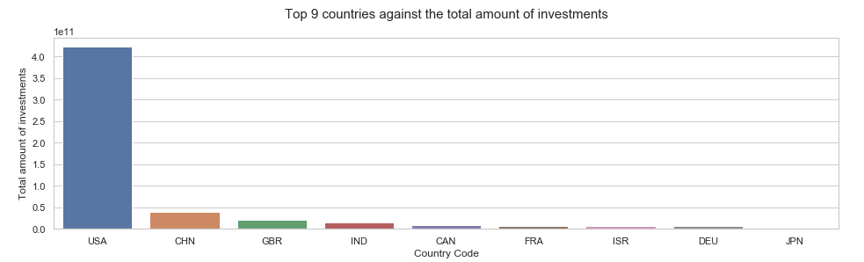
COUNTRY ANALYSIS
Criteria for Spark Funds to choose a country are:
English as the official languages
Highest amount of existing investments into the Venture funding type
Given below are the best choices based on above criteria:
USA (USA)
Great Britain (GBR)
India (IND)
(Checkpoint 6: Plot 2)
Note : China(CHN) does not have English as an official language. Hence excluding it
Best destination USD 422.51B
Second best destination
USD 20.25B
Third best destination
USD 14.39B

Slide 7
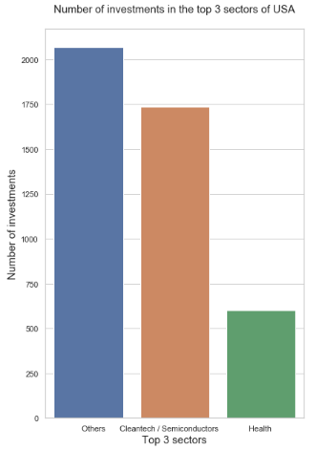
SECTOR ANALYSIS
The eight main sectors available for investment are :
Others
News, Search and Messaging
Entertainment
Cleantech / Semiconductors
Health
Manufacturing
Social, Finance, Analytics, Advertising
Automotive & Sports
Based on the number of investments made in USA in venture funding, main sectors considered best to invest would be :
Top choice - Others
Second choice - Cleantech/Semiconductors
Third choice - Health

Slide 8
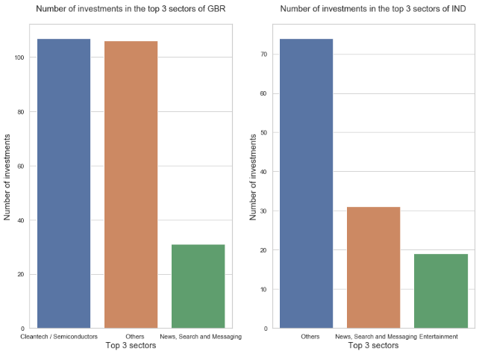
SECTOR ANALYSIS (contd.)
Main sectors that are best to invest for GBR are:
Top choice -Cleantech/Semiconductors
Second choice – Others
Third choice - News, Search and Messaging
Main sectors that are best to invest for IND are:
Top choice – Others
Second choice - News, Search and Messaging
Third choice - Entertainment

Slide 9
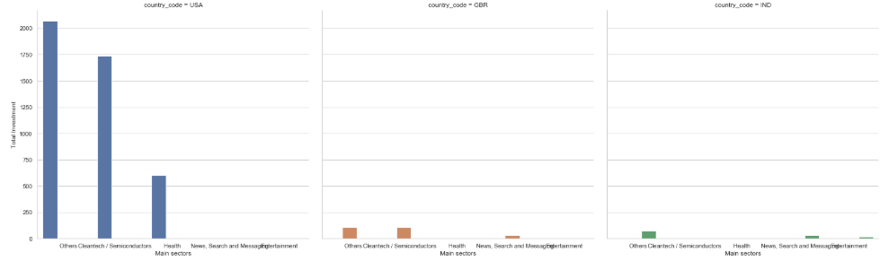
SECTOR,COUNTRY-WISE ANALYSIS
Others:2069
Cleantech..:107
Others:74
This graph indicates the total number of investments made in the top three main sectors in the top 3 countries.
(Checkpoint 6: Plot 3)
Cleantech..:1737
Others:106
News..:31
Health:601
News..
31
Entertainment:19

Slide 10
CONCLUSION
The following inference can be drawn from this case study
Best Funding Type | Top 3 countries | Main sectors to invest | Best companies to invest in
Venture | USA | Others Cleantech / Semiconductors Health | Virtustream Tigo Energy
 | GBR | Cleantech / Semiconductors Others News, Search and Messaging | EUSA Pharma Electric Cloud
 | IND | Others News, Search and Messaging Entertainment | FirstCry.com GupShup

